Slide 1
JAVA SERVER PAGE
MVC ARCHITECTURE

Slide 2
NỘI DUNG
Các mô hình ứng dụng sử dụng trong JSP
Request Dispatcher
Xử lý lỗi trên trang JSP
Sử dụng jsp:plugin

Slide 3
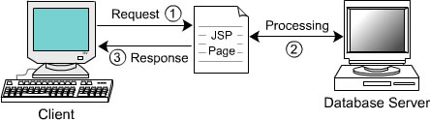
KHÁI NIỆM – MÔ HÌNH 1
JSP xử lý request thông qua các thành phần như scriptlet, custom tag và scripting
Trang JSP dùng JavaBean hay JDBC để truy cập CSDL (nếu có), thực hiện xử lý và trả kết quả (response) cho client.
Áp dụng cho ứng dụng đơn giản
Nhược điểm: không linh hoạt và khó khăn khi chỉnh sửa

Slide 4
VÍ DỤ
Trình bày thông tin sản phẩm (tên, loại sản phẩm)
Bean class
  public class Products
  {
  Định nghĩa các thuộc tính, các phương thức get/set
  }
JSP
  <jsp:useBean id="prod" class="Mod1.Products" scope="session"/>
  <jsp:setProperty name="prod" property="*"/>
  Product Name:<jsp:getProperty name="prod" property="name"/>
  Product Type:<jsp:getProperty name="prod" property="type"/>

Slide 5
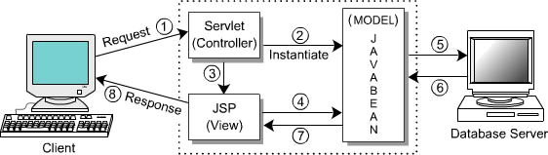
KHÁI NIỆM – MÔ HÌNH 2
Phát triển ứng dụng trên cơ chế điều phối xử lý (controller hay dispatcher) tách biệt giữa giao diện (view) và xử lý.
Việc xử lý request do JSP và servlet thực hiện
Áp dụng cho ứng dụng lớn và phức tạp.
Ưu điểm: khả năng tái sử dụng (reuse) và linh hoạt (flexible)

Slide 6
VÍ DỤ
Model
public class UserInfo{
private String uName;
private String uPass ;
public UserInfo(){ uName = "" ; uPass = "" ; }
public UserInfo(String a , String b){ uName = a ; uPass = b ; }
public String getUName(){ return uName ; }
public String getUPass(){ return uPass ; }
public void setUName(String a){ uName = a ; }
public void setUPass(String a){ uPass = a ; }
boolean checkLogin(){
if (uName.equals("Aptech") && uPass.equals("Aptech")) return true;
return false ; }
}

Slide 7
VÍ DỤ (tt)
View (Login.jsp)
<html>
<head> <title>Login</title> </head>
<body>
<p>Login</p>
<form name="form1" method="post" action="/DemoMVC/Controller">
<input type="hidden" name="action" value="login">
<table width="400" border="1" cellspacing="0" cellpadding="0">
<tr> <td width="128">UserName :</td>
<td width="266"><input type="text" name="txtName"></td> </tr>
<tr> <td>Password :</td>
<td><input type="text" name="txtPass"></td> </tr>
<tr> <td><input type="submit" name="Submit" value="Submit"></td>
<td><input type="reset" name="Reset" value="Reset"></td> </tr>
</table>
<p><a href="Controller?action=new">Register New User - Click Here</a></p>
</form>
</body>
</html>

Slide 8
VÍ DỤ (tt)
View (tt) (Success.jsp)
<html> <head> <title>Login</title> </head>
<body> <H1> Success</H1> </body> </html>
Fail.jsp
<html> <head> <title>Login</title> </head>
<body> <H1> Fail</H1> </body> </html>

Slide 9
VÍ DỤ (tt)
Controller
public class Controller extends HttpServlet{
public void doPost (HttpServletRequest req, HttpServletResponse res) throws ServletException, IOException{
doGet(req , res); }
public void doGet (HttpServletRequest req, HttpServletResponse res) throws ServletException, IOException {
String action = req.getParameter("action");
String url = "" ;
if (action.equals("login")){
String n = req.getParameter("txtName");
String p = req.getParameter("txtPass");
UserInfo bean = new UserInfo(n , p);
if (bean.checkLogin()) {
url = "Success.jsp";}
else {
url = "Fail.jsp";}}
else if (action.equals("new")) {
url = "AddNew.jsp";}
RequestDispatcher rd = req.getRequestDispatcher(url);
rd.forward(req,res);}
}

Slide 10
KHÁI NIỆM – FORWARDING REQUESTS
RequestDispatcher: forward requests đến trang JSP, HTML hay servlet khác (các controller được đưa vào (include) URL) khi thực thi (runtime).
RequestDispatcher đưa ra 02 phương thức hỗ trợ trong JSP
Methods | Cú pháp | Mô tả
include() | <jsp:include page=“trang web" flush = "true") | Đưa toàn bộ nội dung trang Web khác vào trang hiện hành
forward() | <jsp:forward page=“trang web"/> | Chuyển toàn bộ request của trang hiện hành đến trang khác
param | <jsp:param name=“tên” value=“giá trị”/> | Hỗ trợ truyền các tham số khi thực hiện, chỉ tồn tại trong thân của include và forward

Slide 11
VÍ DỤ - INCLUDE
MyDate.jsp
<%@ page import="java.util.Date" %>
<<%= new Date().toLocaleString() %>
MyInclude.jsp
<html>
<head>
<title>Directive Includes JSP program</title>
</head>
<body>
Current date is <jsp:include page = "myDate.jsp" flush="true"/>
</body>
</html>

Slide 12
VÍ DỤ - FORWARD
Forward.jsp
<html>
<head> <title>Forward Example</title> </head>
<body>
<% String test=request.getParameter("companyID");
if(test==null){ %>
<jsp:forward page="Aptech.jsp">
<jsp:param name="title" value="Aptech"/>
<jsp:param name="Uname" value="JSP course"/>
</jsp:forward>
<% } else { out.println("Sorry, no match value found"); }%> </body>
</html>
Aptech.jsp
<html>
<head> <title>Forward Example</title> </head>
<body>
<% out.println(request.getParameter("title"));
out.println(request.getParameter("Uname")); %> </body>
</html>

Slide 13
FORWARDING REQUESTS – SERVLET
Xử lý RequestDispatcher thường sử dụng trong Servlet
  Dễ lập trình
  Việc xử lý dữ liệu đơn giản
  Hỗ trợ việc lưu trữ thông tin.
Thực hiện thông qua phương thức getRequestDispatcher của ServletContext
  RequestDispatcher d=request.getRequestDispatcher(url);
HttpServletRequest và HttpServletResponse sẽ hỗ trợ công việc của RequestDispatcher
Servlet 2.2 cho phép gửi forward Request Dispatcher có truyền tham số bằng cách tạo url theo dạng “/path/abc.jsp?a_param=value”;
Thực hiện Request Dispatcher với phương thức forward
  d.forward(request, response);
Hint: Tạo phương thức (ví dụ gotoPage) để có thể sử dụng linh hoạt Request Dispatcher trên servlet.

Slide 14
VÍ DỤ
Ứng dụng trình bày, tìm kiếm thông tin về chuyến bay để thực hiện đặt chỗ
  Người sử dụng thông qua trang HTML nhập thông tin (địa chỉ email, password ...) để xác nhận thông tin. Nếu account tồn tại (thông qua Servlet để gửi thông tin đến Bean class xử lý – forward page hiển thị) để trình kết quả trên trang JSP.
HTML
  <form action="/TravelServlet" method="post">
  <center>
  Email: <input type="text" name="email"><br>
  Password: <input type="password" name="password" size="10"><br>
  Origin: <input type="test" name="origin"><br>
  Destination: <input type="text" name="destination"><br>
  Start Date: <input type="text" name="startDate" size="8"><br>
  End Date: <input type="text" name="endDate" size="8"><br>
  <br><input type="submit" name="flights" value="Book Flight">
  </center>
  </form>
  <p align="center">
  <b>Not yet remember? Get a free account <a href="accounts.jsp">here</a></b>
  </p>

Slide 15
VÍ DỤ (tt)
Servlet
public class travel extends HttpServlet {
private travelCustomer[] travelD;
public void init(){ travelD=travelData.getTravelData();}
public void doPost(HttpServletRequest request, HttpServletResponse response)throws ServletException, IOException{
String email=request.getParameter("email");
String password=request.getParameter("password");
travelCustomer customer=travelCustomer.findCustomer(email, travelD);
if(customer==null || password==null || !password.equals(customer.getPassword())){
gotoPage("/travel/accounts.jsp", request, response);}
customer.setStartDate(request.getParameter("startDate"));
customer.setEndDate(request.getParameter("endDate"));
customer.setOrigin(request.getParameter("origin"));
customer.setDestination(request.getParameter("destination"));
System.out.println("set Info Ok");
HttpSession session=request.getSession(true);
session.putValue("customer", customer);
if(request.getParameter("flights")!=null){ gotoPage("/travel/BookFlights.jsp", request, response); }
else{ gotoPage("/travel/IllegalRequest.jsp", request, response);}}
private void gotoPage(String address, HttpServletRequest request, HttpServletResponse response)throws ServletException,IOException{
RequestDispatcher dispatcher = getServletContext().getRequestDispatcher(address);
dispatcher.forward(request, response);}
}

Slide 16
VÍ DỤ (tt)
JSP
<jsp:useBean id="customer" class="MVC.travelCustomer" scope="session" />
Find Flight for <jsp:getProperty name="customer" property="fullName"/>
<jsp:getProperty name="customer" property="flights"/>
<form action=“...">
<jsp:getProperty name="customer" property="freFlyTable"/>
Credit card: <jsp:getProperty name="customer" property="creditCard"/>
<input type="submit" name="holdButton" value="Hold for 24 hours">
<input type="submit" name="bookItButton" value="Book It">
</form>

Slide 17
VÍ DỤ (tt)
Bean class
public class travelCustomer
{
Các phương thức get/set và thuộc tính email, password, firstname, lastname, creditcardNum, creditcardName, phoneNum, homeAddress, startDate, endDate, departure, destination, freFly
Các phương thức trình bày dữ liệu lên màn hình
}

Slide 18
XỬ LÝ LỖI TRÊN TRANG JSP
Exception: lỗi xuất hiện trong quá trình xử lý.
Exception là Implicit Object trong trang xử lý lỗi
  getMessage(): lấy error Message.
  toString(): chuyển lỗi thành chuỗi.
Lỗi được trang JSP chuyển đến trang lỗi.
Cách xử lý lỗi trên trang JSP
  Trang cần xử lý lỗi khai báo
  <%@ page errorPage = “trang jsp” %>
  Trang xử lý lỗi:
    Có khai báo <%@ page isErrorPage = “true” %>
    Dùng các phương thức của Exception để báo lỗi
Có 02 loại lỗi
  Translation time errors
  Request time errors

Slide 19
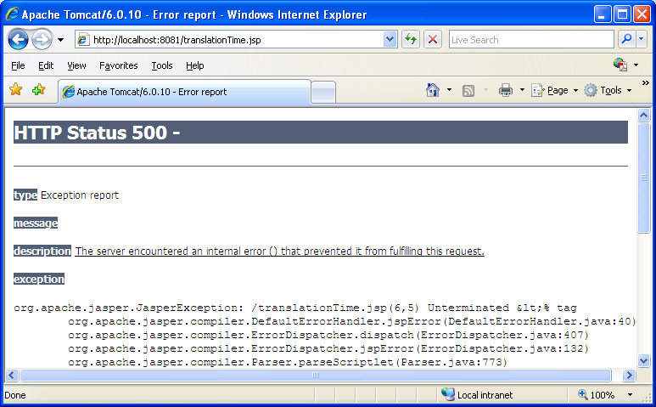
TRANSLATION TIME ERRORS
Lỗi xuất hiện khi JSP source chuyển đổi thành servlet class
Lỗi cú pháp trong quá trình lập trình
Ví dụ
<html>
<head>
<title>Translation Time Errors</title>
</head>
<body>
<% out.println("<h1> Exception Errors! </h1>");
</body>
</html>

Slide 20
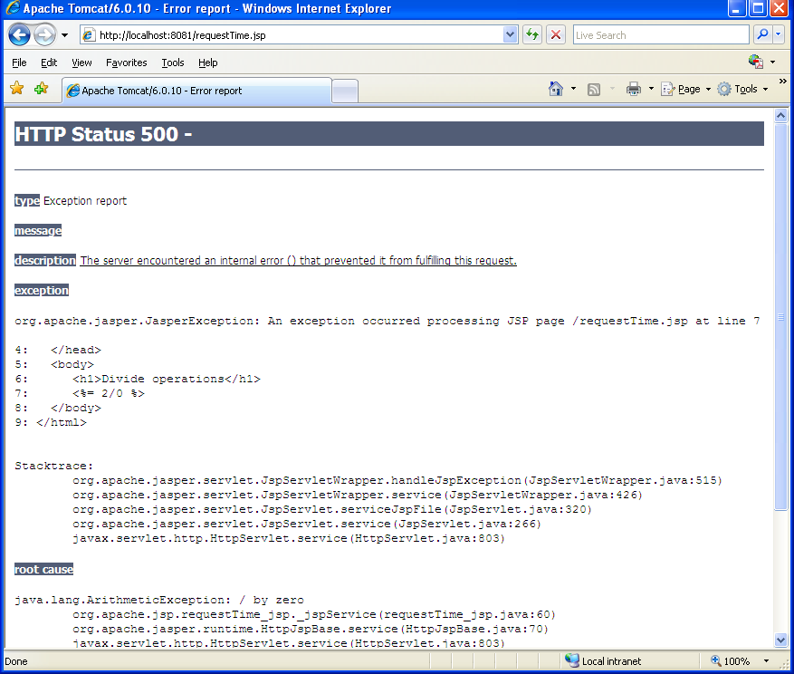
REQUEST TIME ERRORS
Lỗi xuất hiện trong quá trình xử lý các request
Lỗi do xử lý trong trang JSP hay từ các đối tượng được trang JSP gọi thực hiện.
Ví dụ
<html>
<head>
<title>Request Time Errors</title>
</head>
<body>
<h1>Divide operations</h1>
<%= 2/0 %>
</body>
</html>

Slide 21
VÍ DỤ SỬ DỤNG TRANG XỬ LÝ LỖI
Trang JSP có sử dụng trang xử lý lỗi
<%@ page errorPage="error.jsp" %>
<html>
<head> <title>Tag Example</title> </head>
<body>
<%! String name; %>
<% name = request.getParameter("name");
if(name==null) name="World“; %>
<h1>Hello, <%= name %></h1>
<% out.println("<H1>Hello " + name + "</H1>"); %>
<% int num=Integer.parseInt("a"); %> </body>
</html>

Slide 22
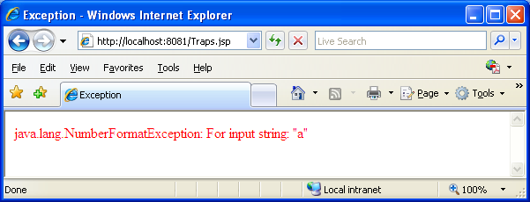
VÍ DỤ SỬ DỤNG TRANG XỬ LÝ LỖI (tt)
Trang xử lý lỗi (error.jsp)
<%@ page isErrorPage="true" import="java.io.*" %>
<html>
<head>
<title>Exception</title>
</head>
<body>
<font color="red">
<%= exception.toString() %>
</font>
</body>
</html>

Slide 23
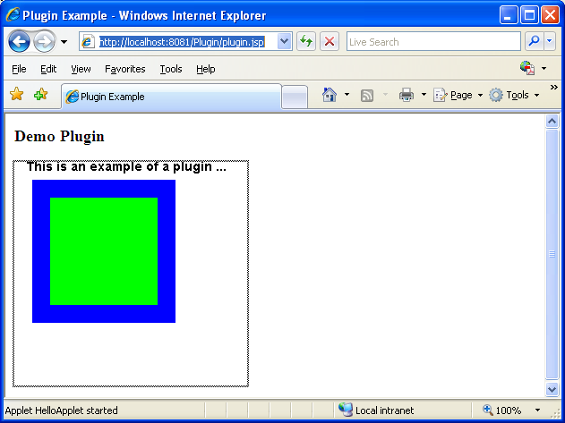
SỬ DỤNG JSP:PLUGIN
Thực thi đối tượng khác (applet, Java bean …) trong trang JSP
Đưa đối tượng vào trang JSP theo cú pháp
<jsp:plugin type = “loại đối tượng” code = “tên class” />
Ví dụ

Slide 24
VÍ DỤ
Applet
import java.applet.*;
import java.awt.*;
public class HelloApplet extends Applet {
public HelloApplet(){}
public void init(){}
public void paint(Graphics g){
Font f=new Font("TimesRoman", Font.BOLD, 14);
g.setFont(f);
g.drawString("This is an example of a plugin ...", 14, 10);
Color c=new Color(0, 0, 255);
g.setColor(c);
g.fillRect(20, 20, 160, 160);
Color c1=new Color(0, 255, 0);
g.setColor(c1);
g.fillRect(40, 40, 120, 120);}
}

Slide 25
VÍ DỤ (tt)
Trang JSP
<html>
<head>
<title>Plugin Example</title>
</head>
<body bgcolor="white">
<h3>Demo Plugin</h3>
<jsp:plugin type="applet" code="HelloApplet.class" width="260" height="250"/>
</body>
</html>

Slide 26
Bài tập
Thực hiện lại các bài tập demo
Áp dụng các bài tập lần trước đưa vào xử lý lỗi
Viết các ứng dụng xử lý banking.

